Slide 1
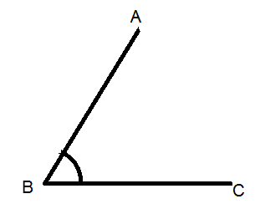
Naming Angles
This angle is called
∠ABC
∠B
∠CAB

Slide 2
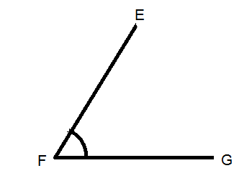
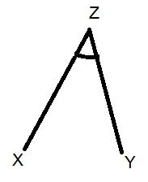
Name these angles
Notes:
There is an extra worksheet available to assign as homework

Slide 3

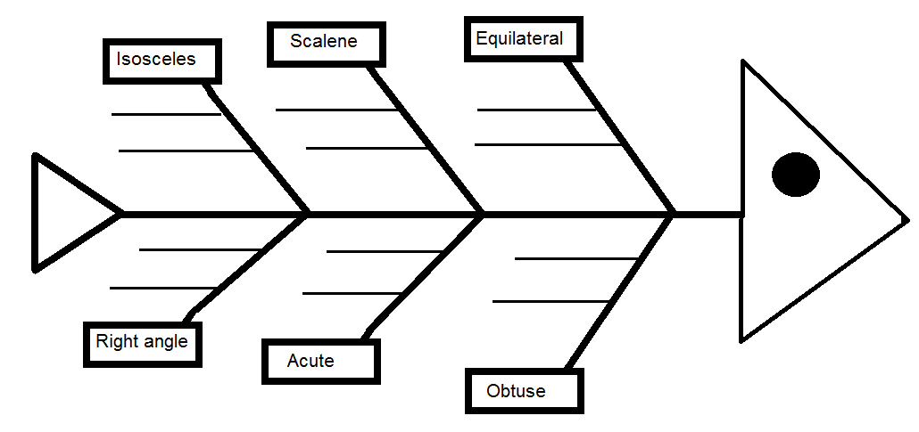
Fish Bone
Complete the fish bone
For types of Triangles
WICOR
Notes:
You can either deliver this as expert groups or just present the notes on the board and have student fill them in
Hand out fish bone template

Slide 4
Isosceles
Two sides are equal
Two angles are equal

Slide 5
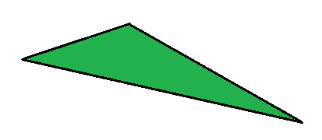
Scalene
No sides equal
No angles equal

Slide 6
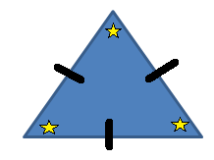

Equilateral
All sides are equal
All Angles are equal

Slide 7
Right angle
One Right Angle (90°)

Slide 8
Acute
Three Acute angles
(less than 90°)

Slide 9
Obtuse
One angle greater than 90°

Slide 10
Lesson objective
By the end of this lesson you will be able to;
Classify the different types of triangles
Notes:
Lesson

Slide 11
24
7
30
Date
Triangles
EQ – How can we classify different triangles
Angles inside a triangle add up to 180°
Glue your Fish Bone here
5
Notes:
Lesson objective (EQ)

Slide 12
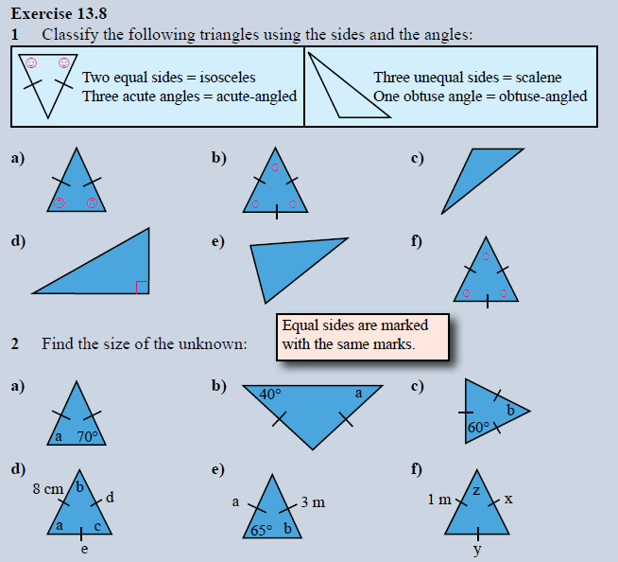
Notes:
Practice

Slide 13
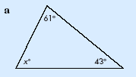
We can use this fact to find an unknown angle in a triangle.
Example: Find the unknown angle xº.
Answer: Since we know the sum of all three angles must equal 180º it follows that:
xº + 61º + 43º = 180º
xº = (180 - 61 - 43)º
xº = 76º

Slide 14
We can use this fact to find an unknown angle in a triangle.
Example: Find the unknown angle xº.
Answer: Since we know the sum of all three angles must equal 180º it follows that:
xº + 61º + 43º = 180º
xº = (180 - 61 - 43)º
xº = 76º

Slide 15
EXTERIOR ANGLES
θº

Slide 16
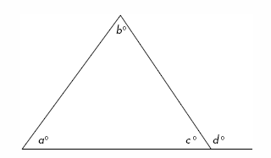
Two things we now know about angles…
1. The internal angles of a triangle add up to 180º. So from above aº + bº + cº = 180º
2. The angle of a straight line = 180º. So from above cº + dº = 180º

Slide 17
We can use these two facts to help us find out the exterior angle, dº
We know:
aº + bº + cº = 180º
cº + dº = 180º
As both equal 180º, we can see that:
aº + bº + cº = cº + dº
aº + bº = dº
The above equation tells us that:
THE EXTERIOR ANGLE IS EQUAL TO THE SUM OF THE TWO OPPOSITE INTERIOR ANGLES.

Slide 18
Worked example: finding an exterior angle
Find the exterior angle, xº
The two opposite interior angles are 66º and 62º.
We know the sum of these angles must equal xº.
66º + 62º = xº
128º = xº

Slide 19
Worked example 2:
Find xº.
We seem to be only given one of the two opposite internal angles.
However the triangle is an isosceles triangle, therefore the other opposite internal angle must also be 50º.
So 50º + 50º = xº
100º = xº

Slide 20
Exit Pass
Name the triangle
I have all side and angles equal
I have two side of equal length
All my angles are less than 90°
I have 2 sides of equal length and I have an angle greater than 90°
WICOR
Notes:
Closure/ exit pass

Slide 21
Exit Pass
Name the triangle
I have all side and angles equal
Equilateral Triangle
I have two side of equal length
Isosceles Triangle
All my angles are less than 90°
Acute Triangle
I have 2 sides of equal length and I have an angle greater than 90°
Obtuse Isosceles Triangle
Notes:
Closure/ exit pass

